Slide 1


Slide 2
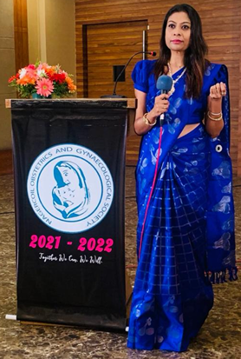
Secretary’s Report March 2021

Slide 3


Slide 4
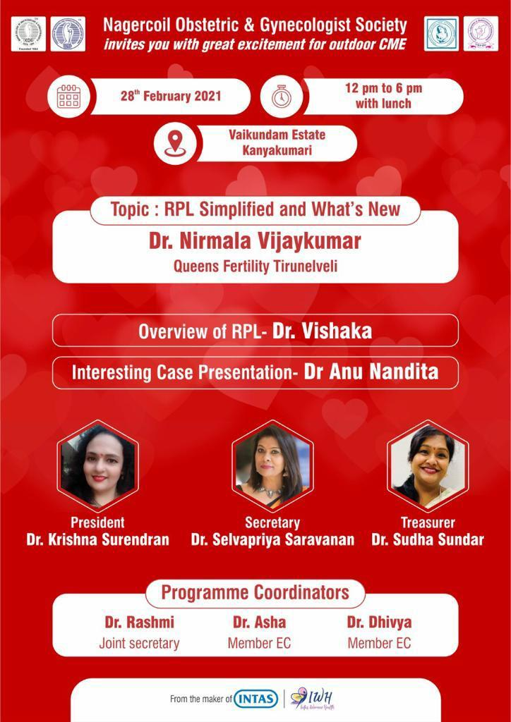

Slide 5
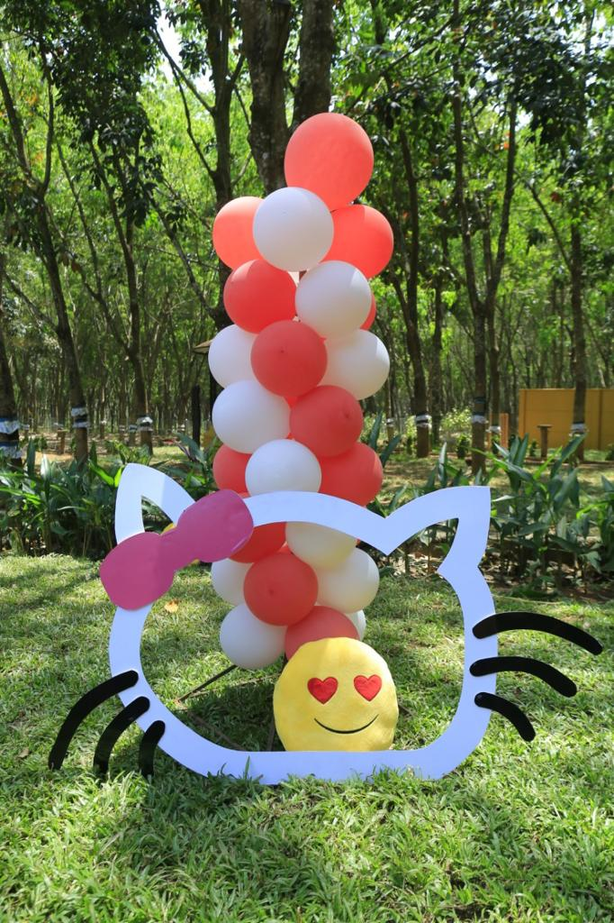
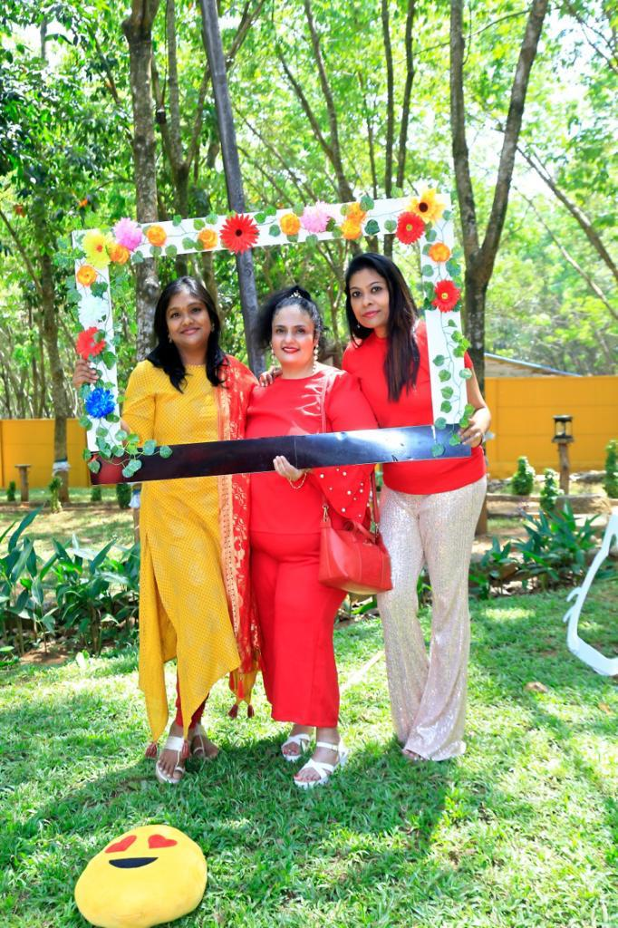

Slide 6
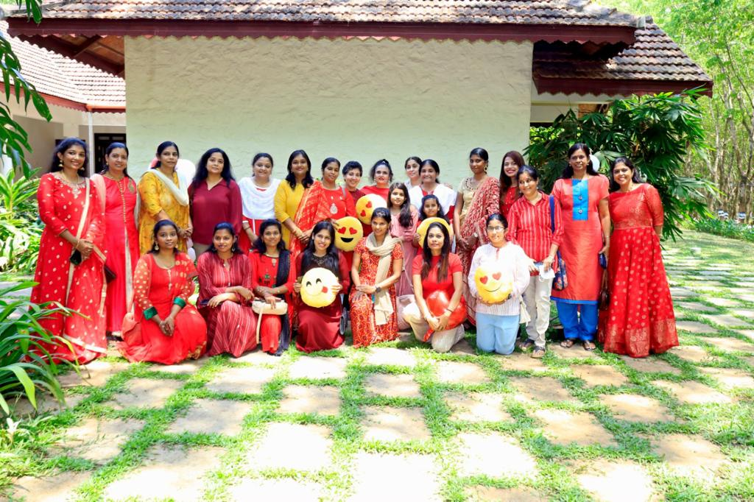
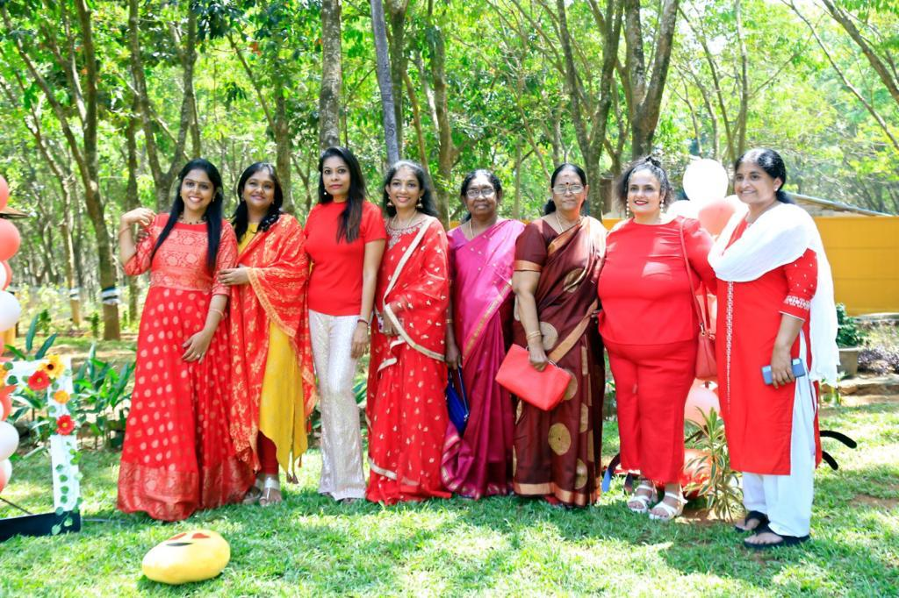
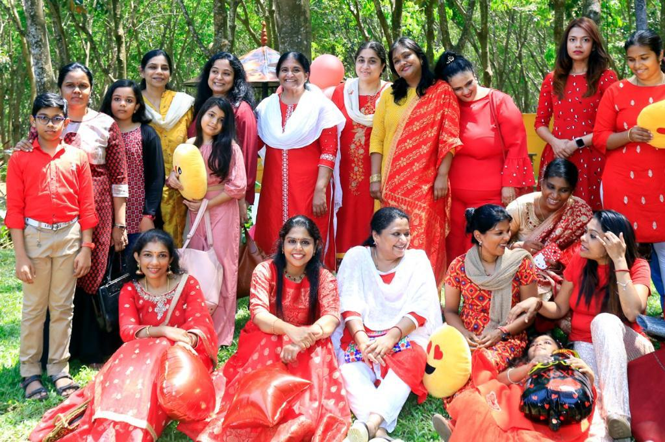

Slide 7
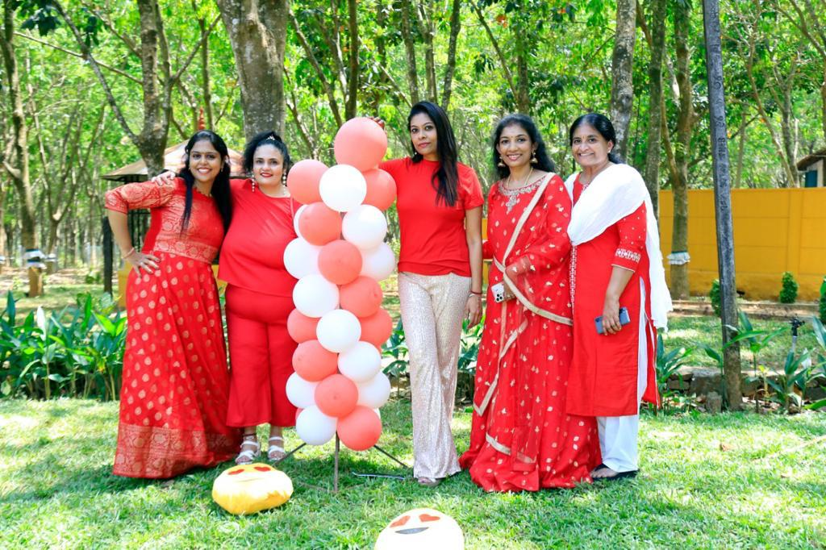
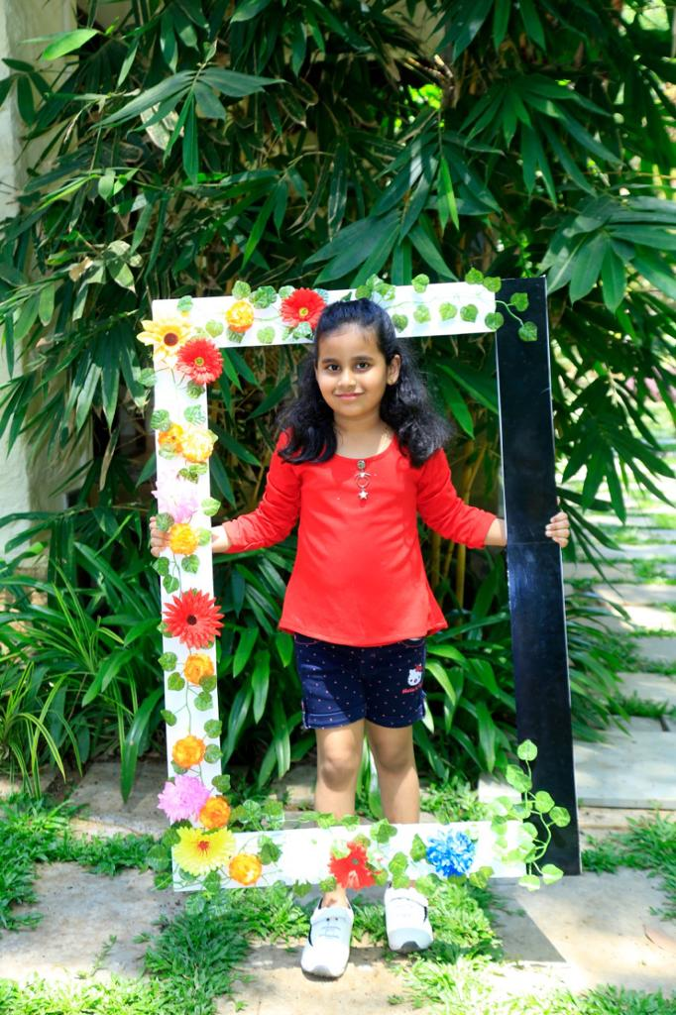
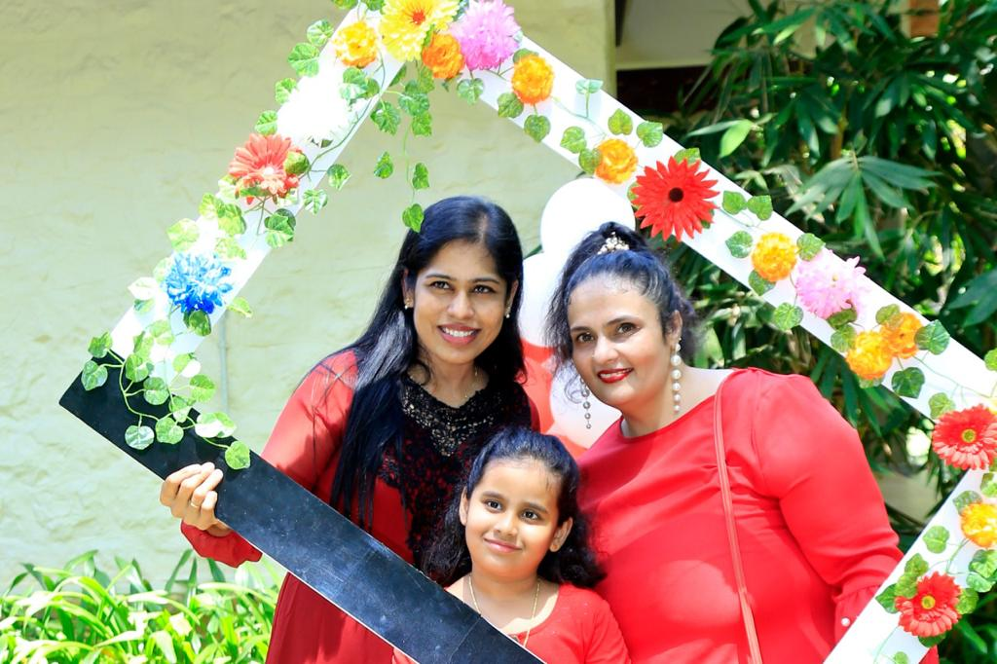

Slide 8
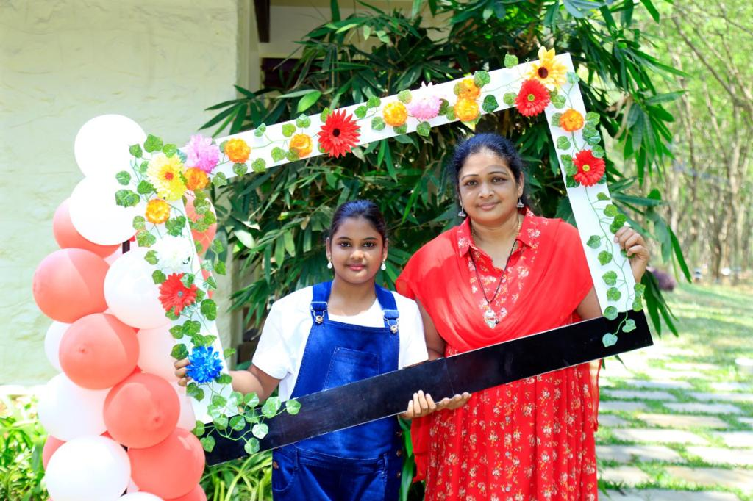
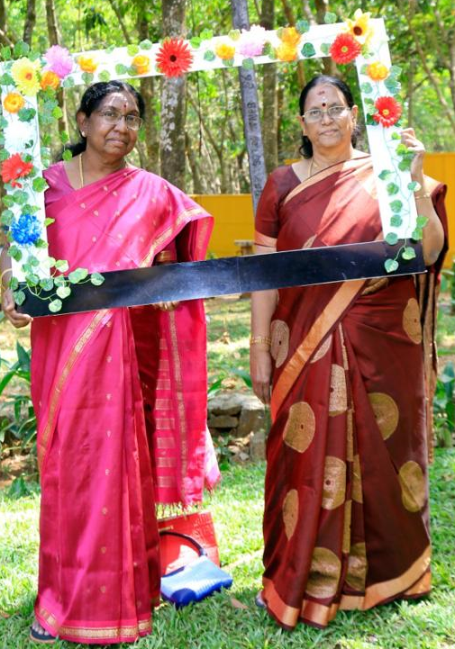
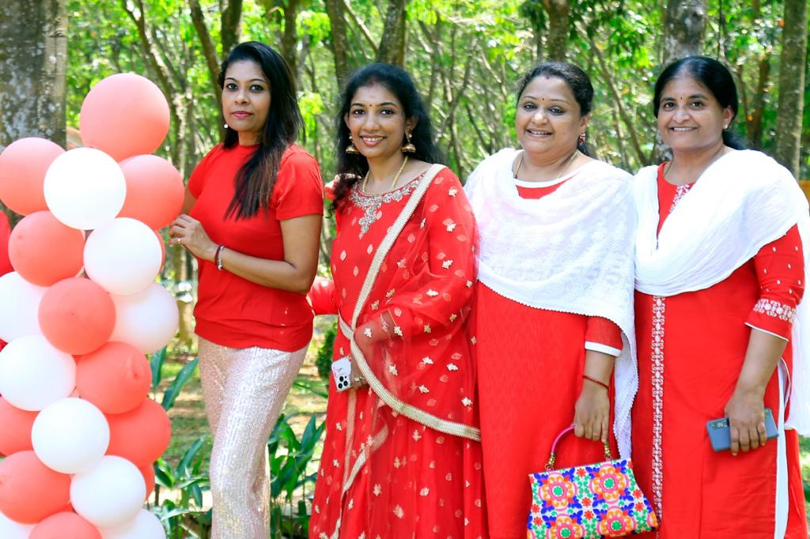
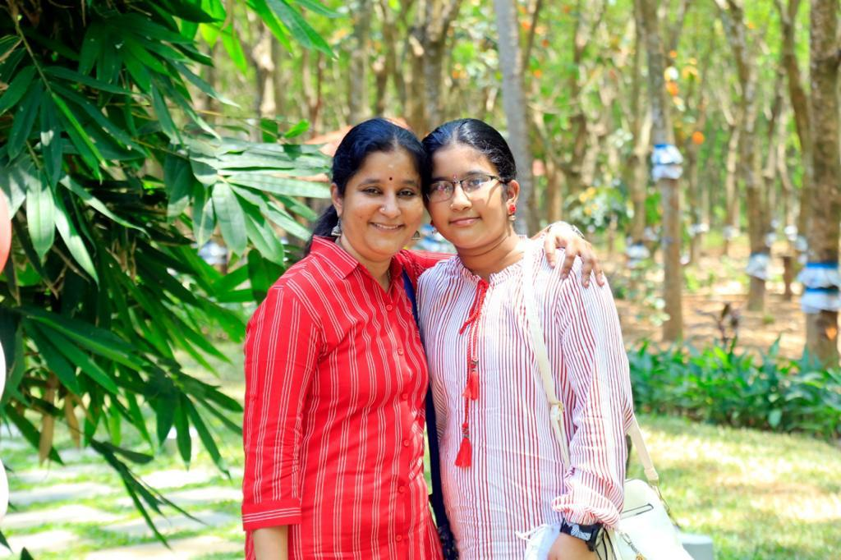
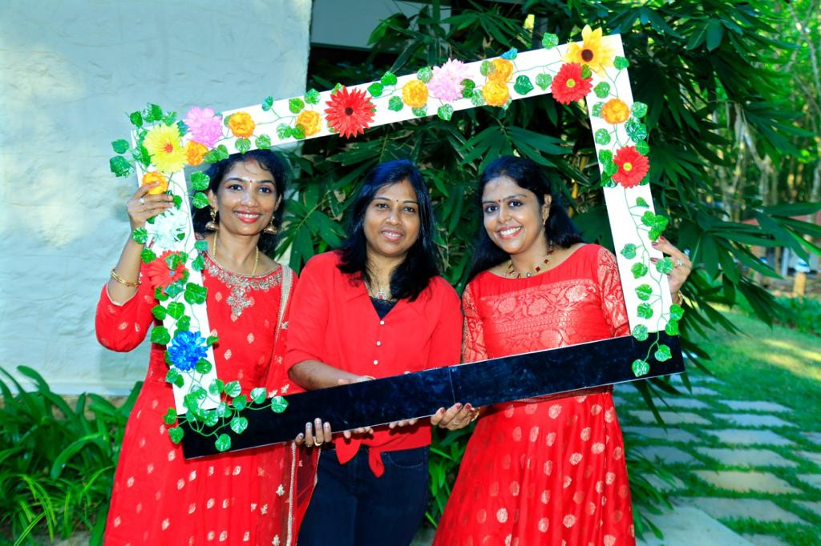

Slide 9
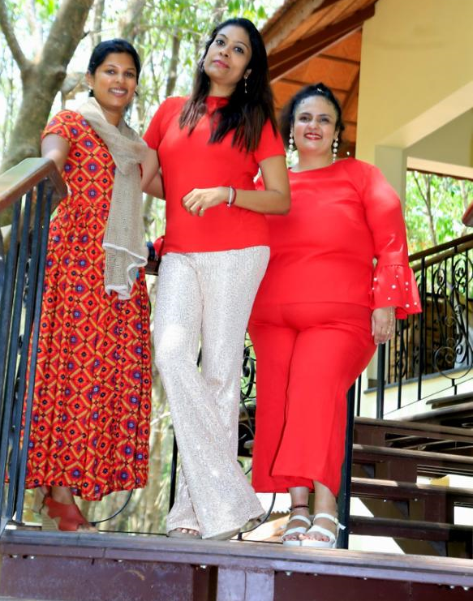
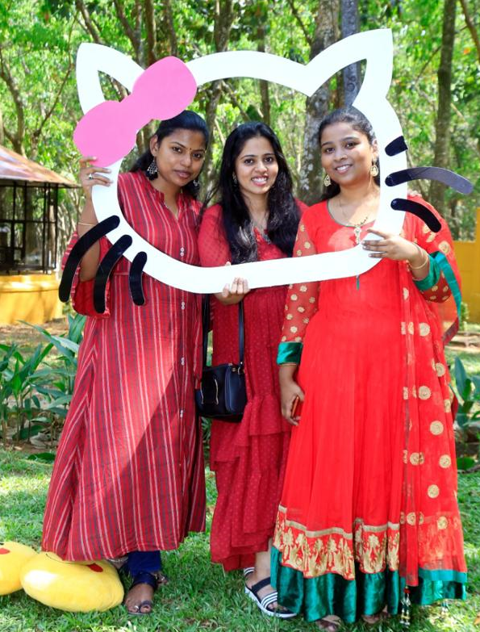
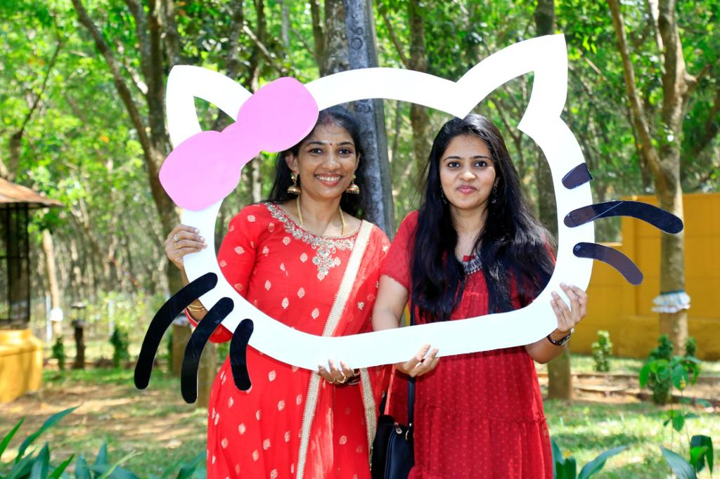
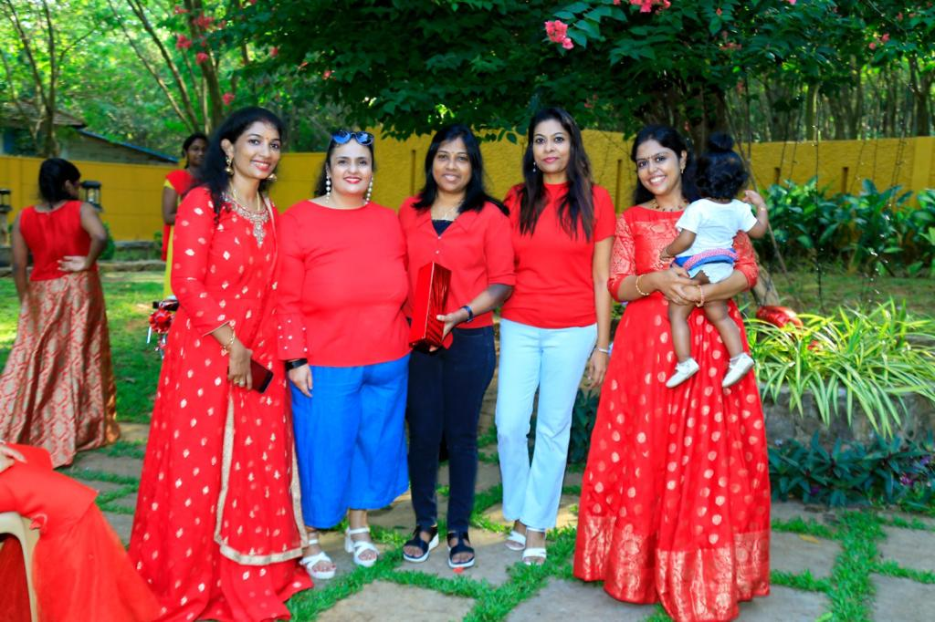

Slide 10
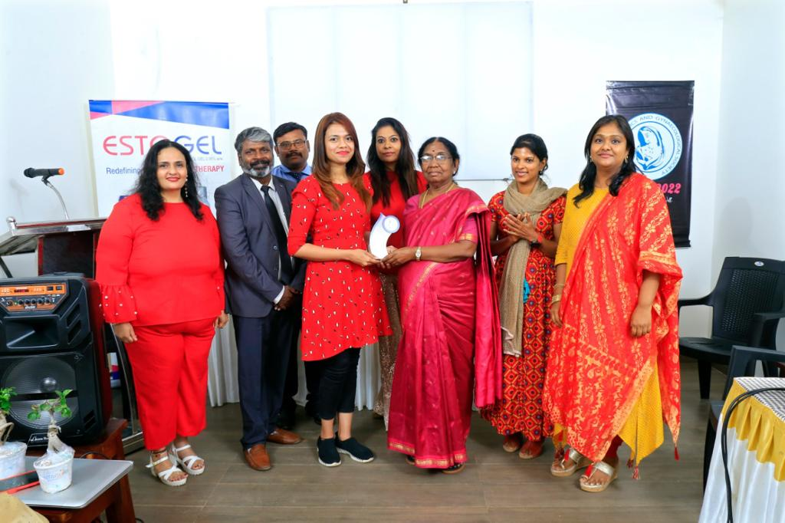
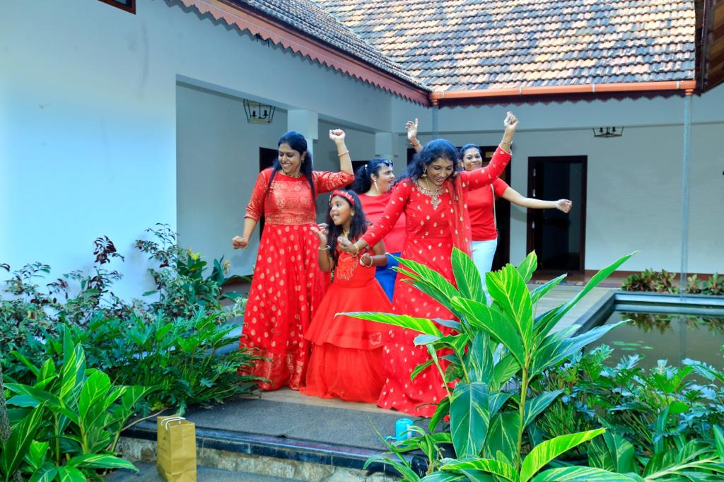
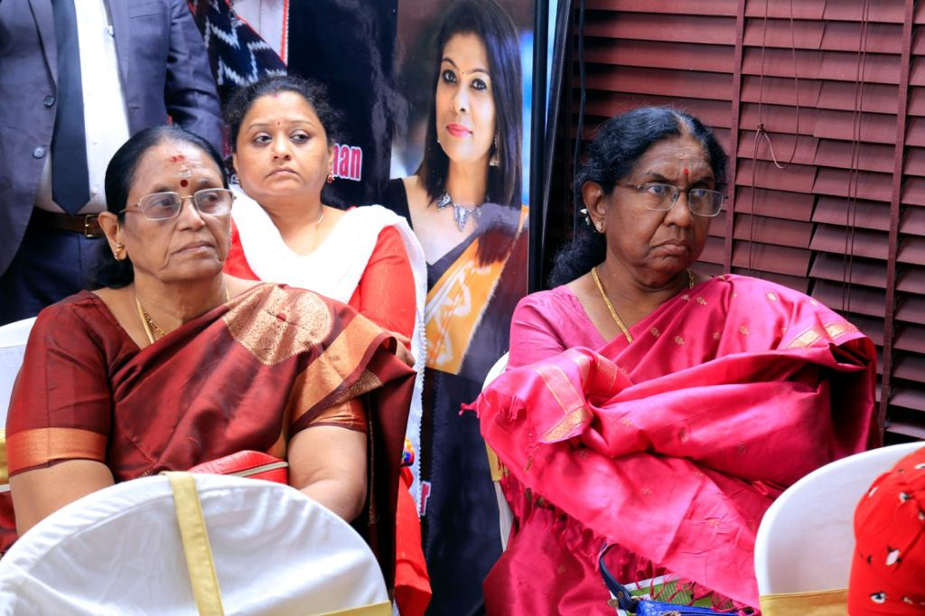
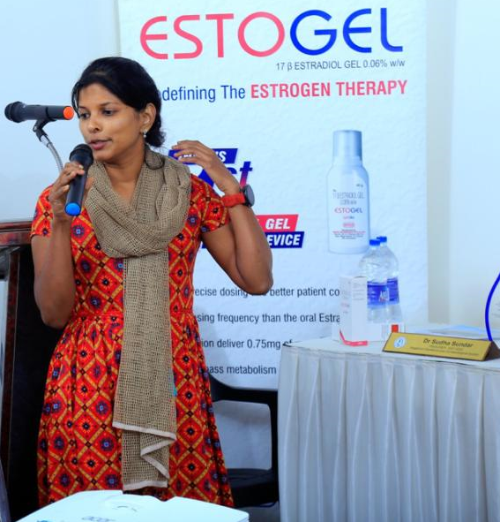
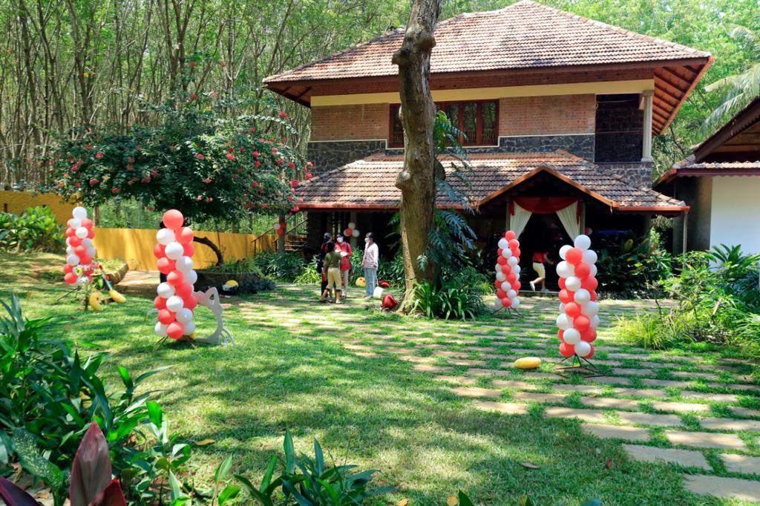

Slide 11
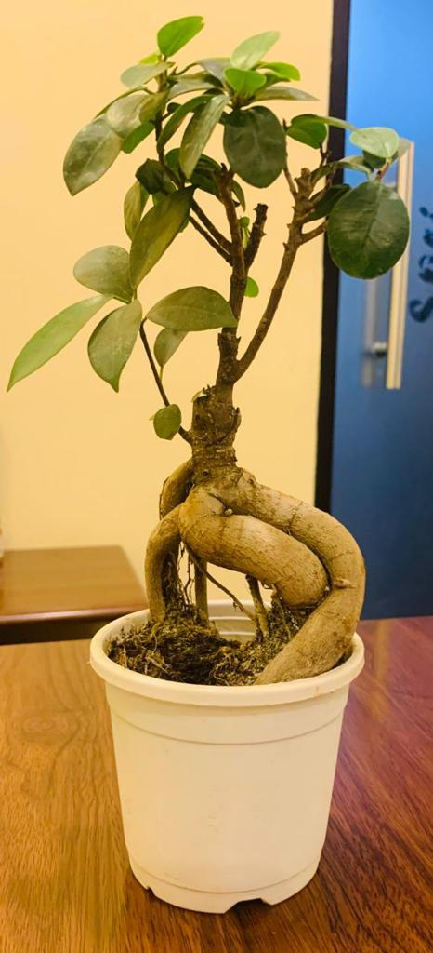
GIFTS

Slide 12


Slide 13

Women’s Day Celebration

Slide 14
NOGS project 15 WDP (10) Dr.Mini Gopal our PP and Dr Krishna our president did the FOGSI Cancer Awareness Programme for paramedical staff and screening camp for public on March 8 in GOPALAPILLAI hospital

Slide 15
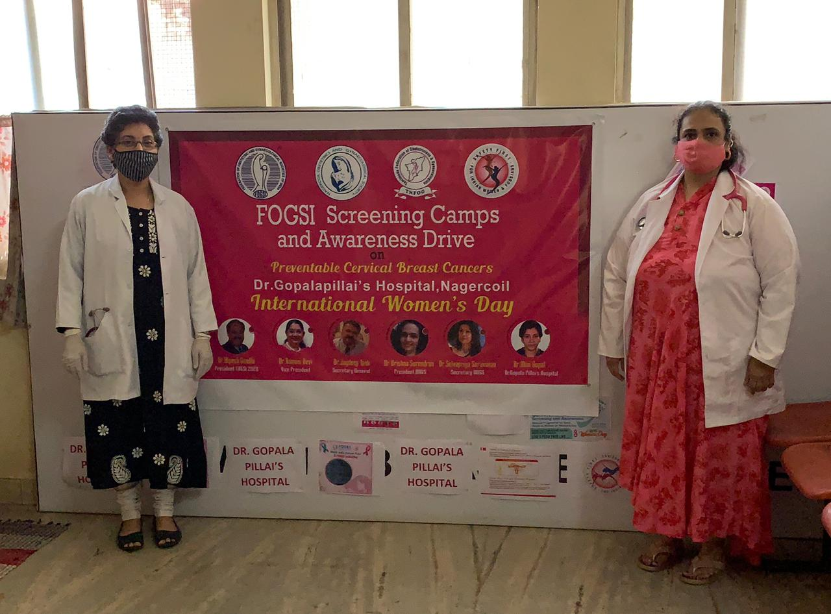
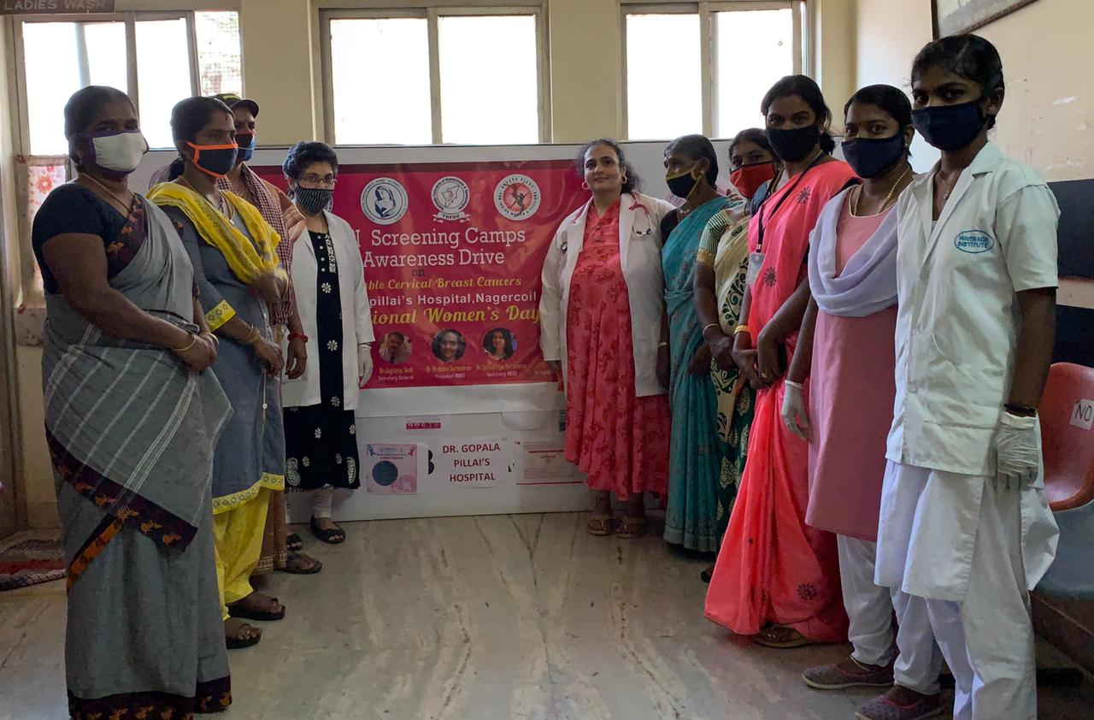
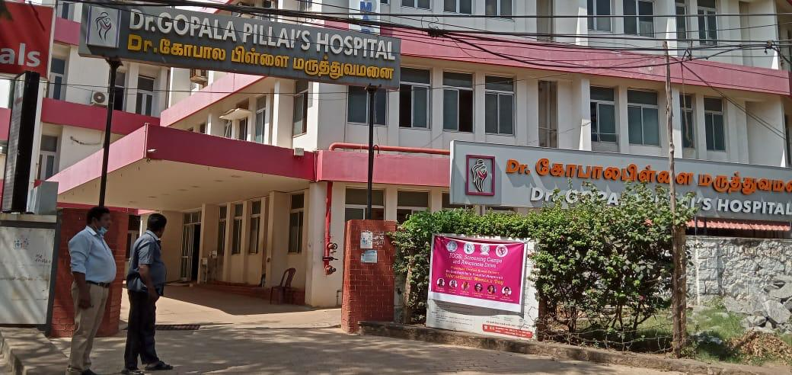
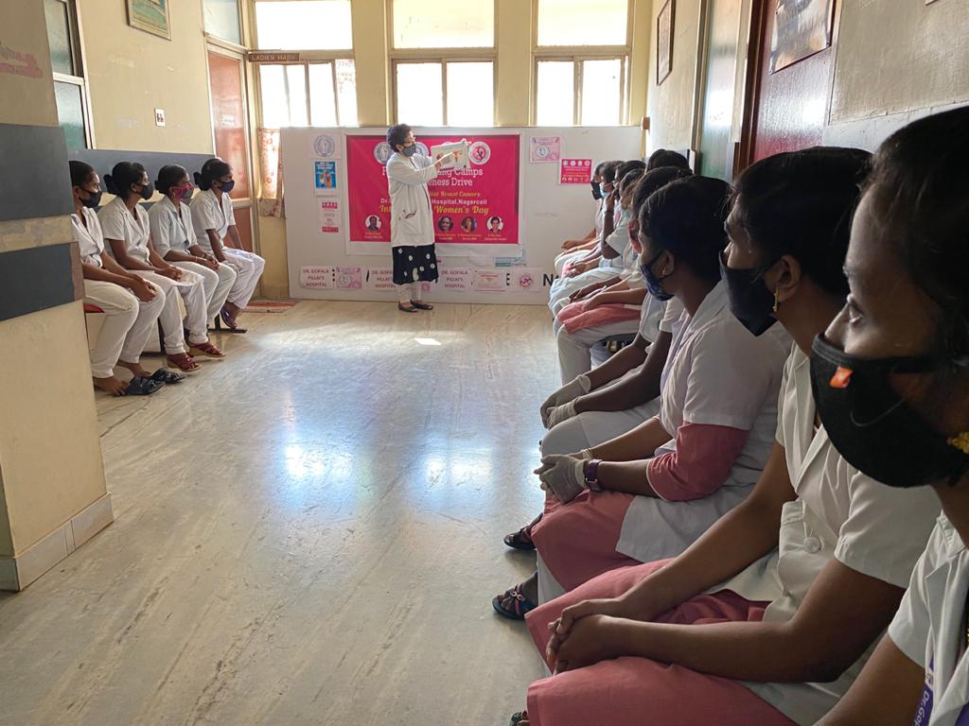

Slide 16
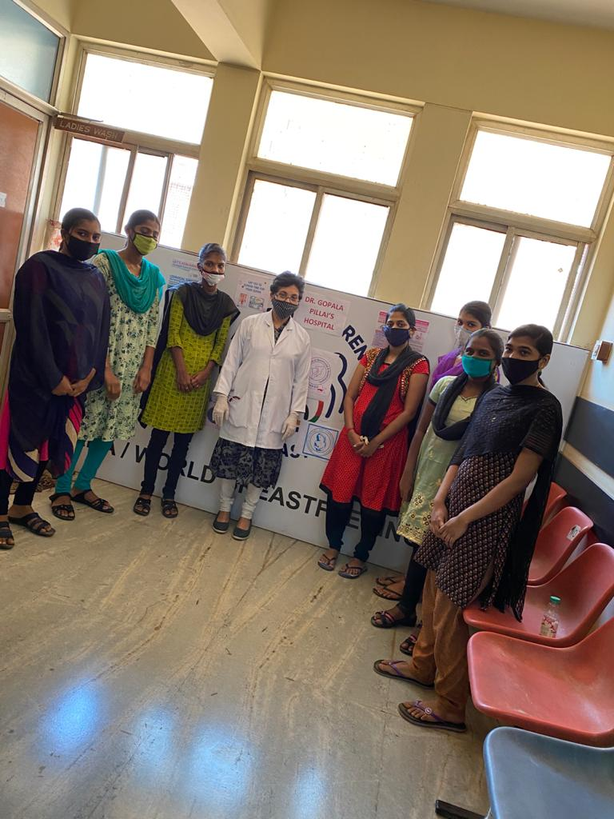
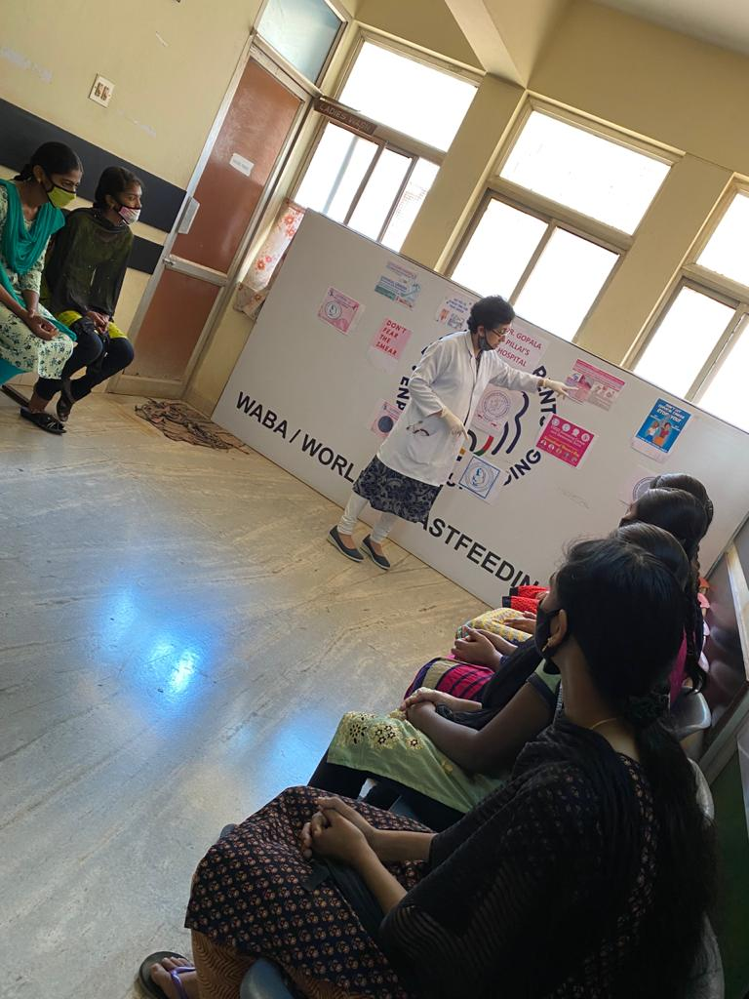

Slide 17

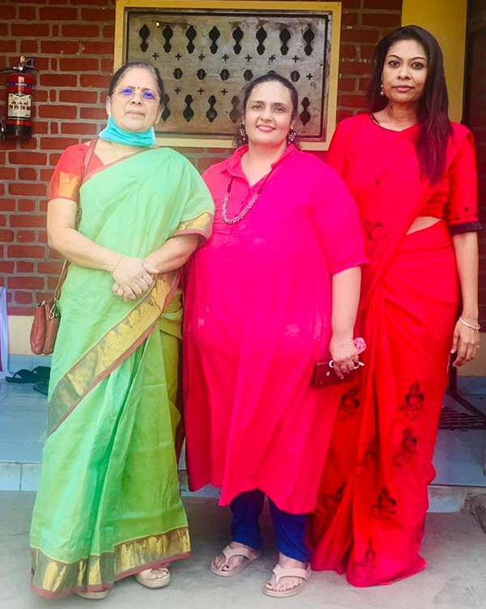
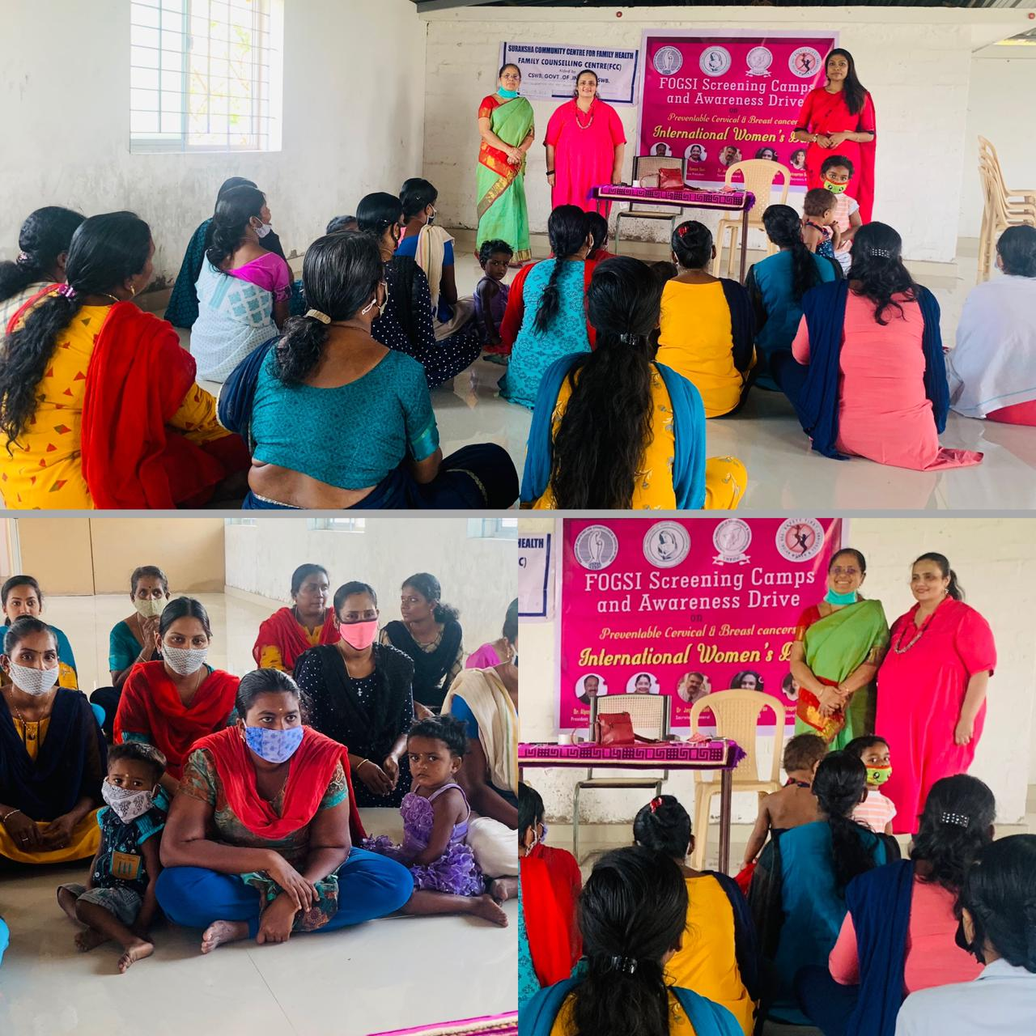

Slide 18
NOGS Project 20 (3/24) ... Dr.Krishna and Dr.Selvapriya president and secretary Nagercoil OBG Society ...
Did Adolescent Health Awareness Programme for class X students of Duthie Girls School on 18/03/2021…

Slide 19
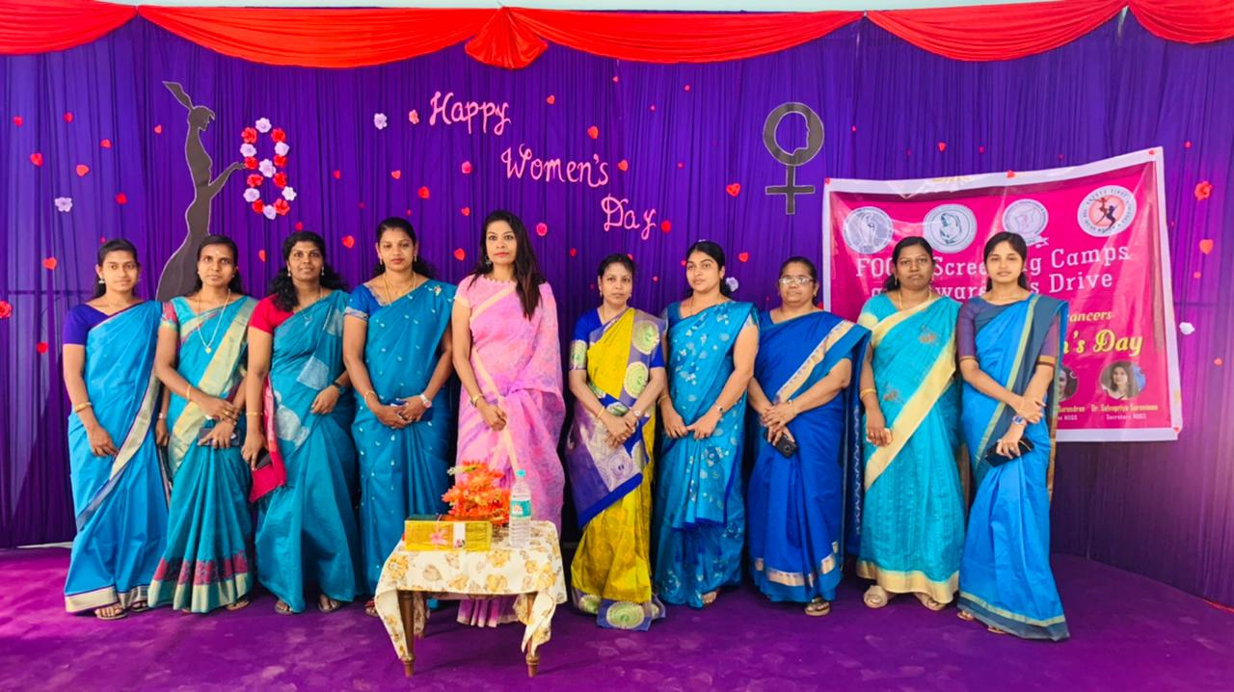
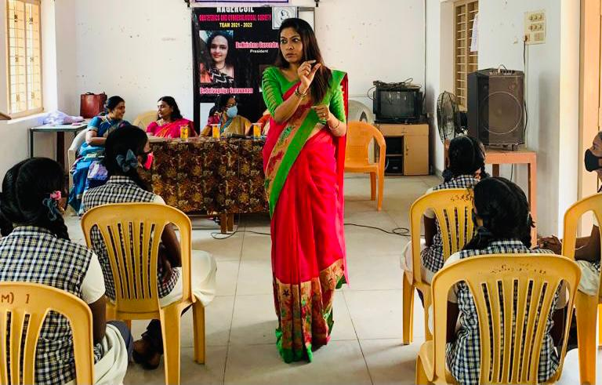
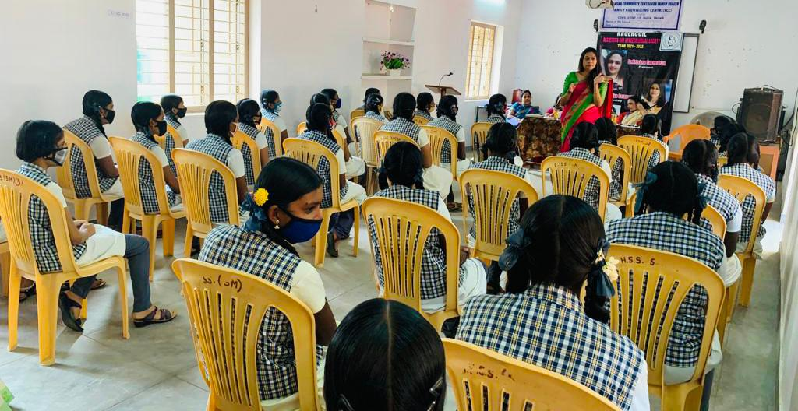
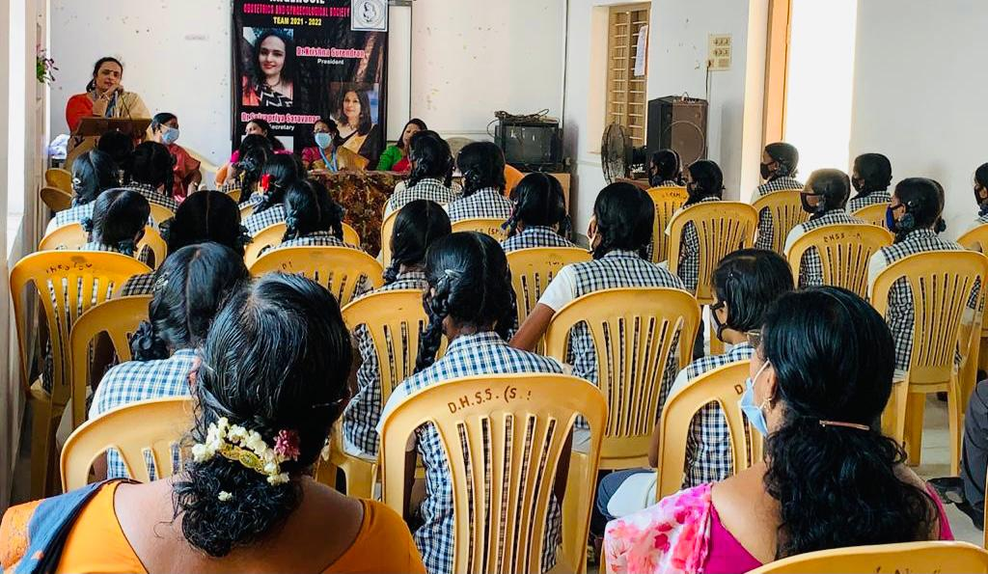
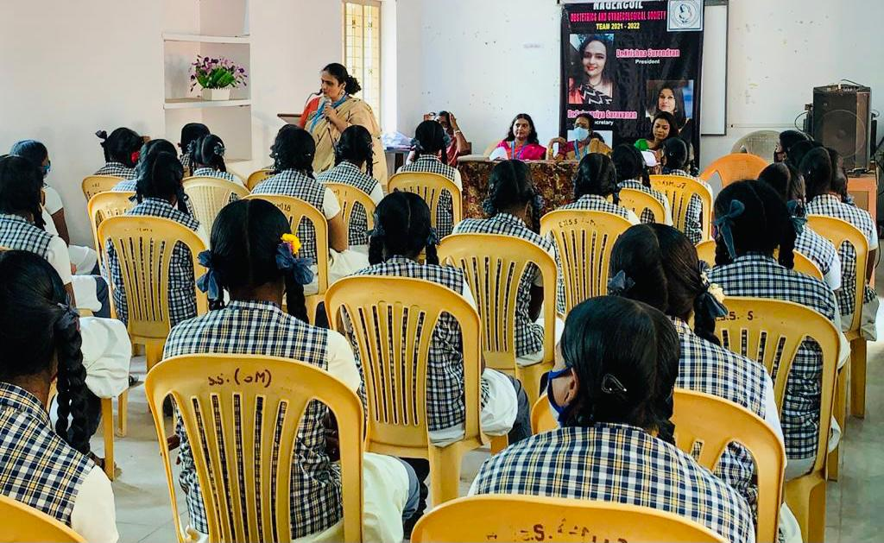

Slide 20

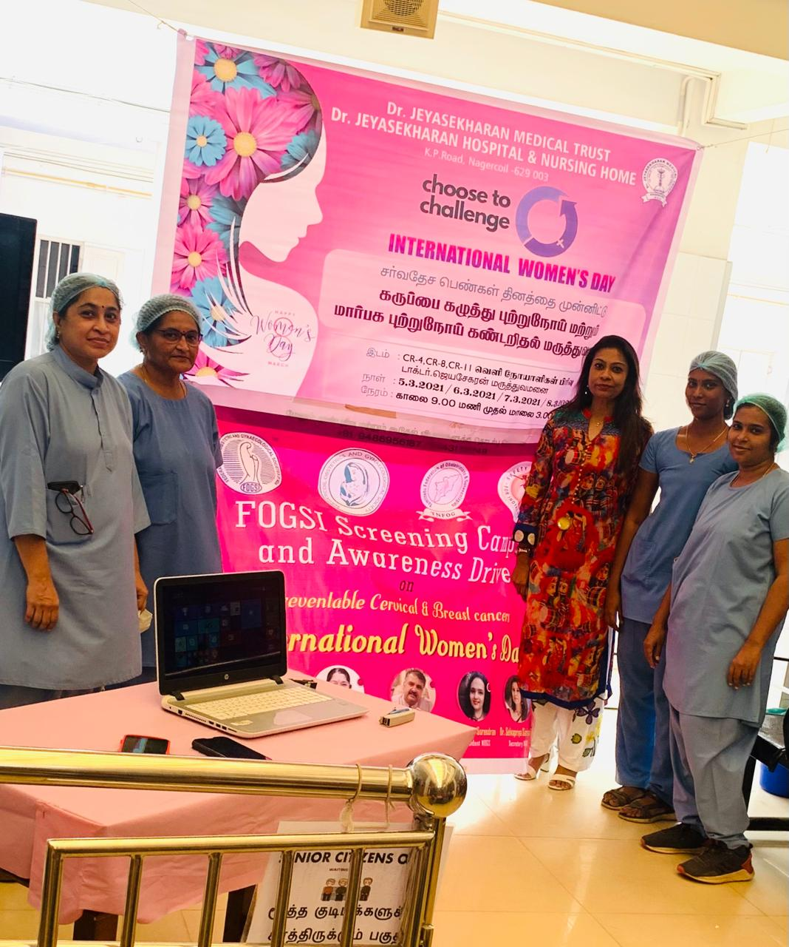
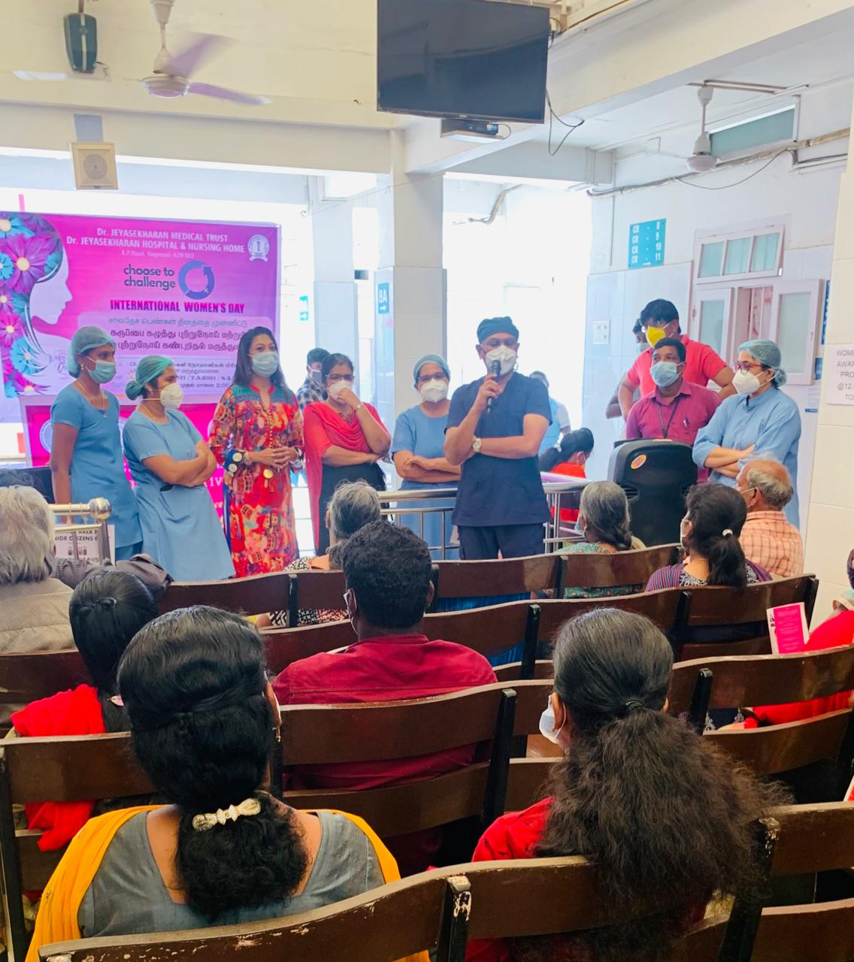
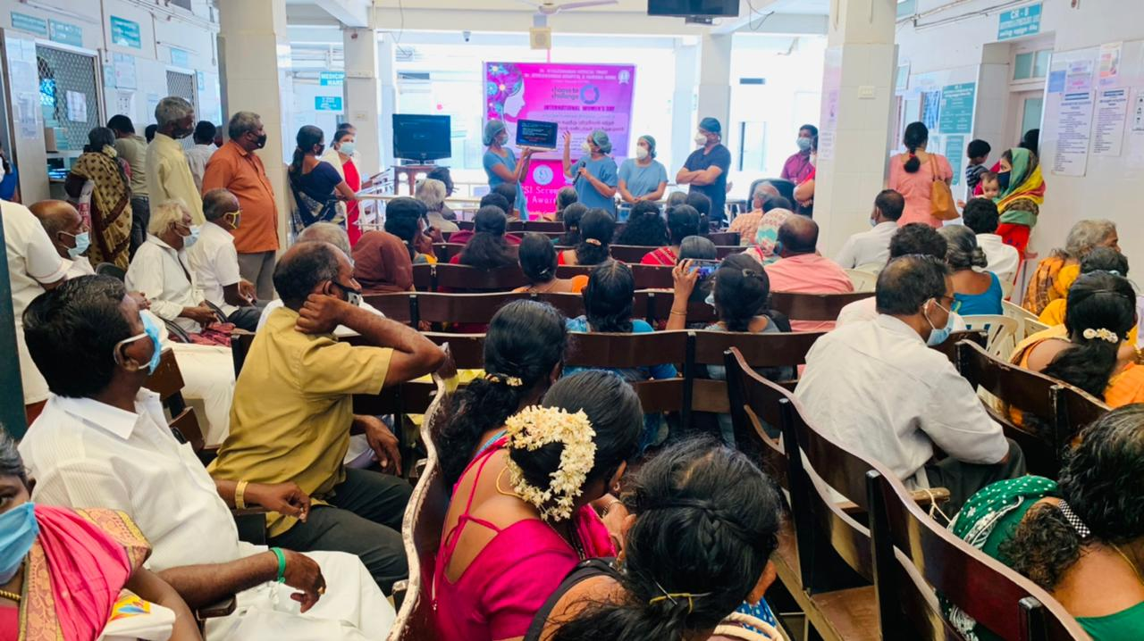

Slide 21
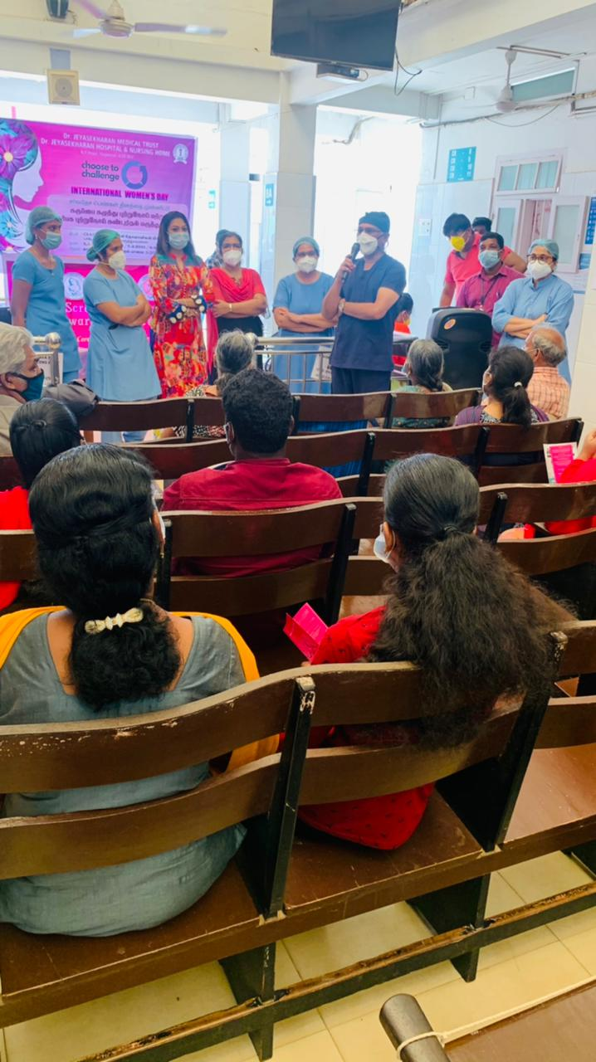
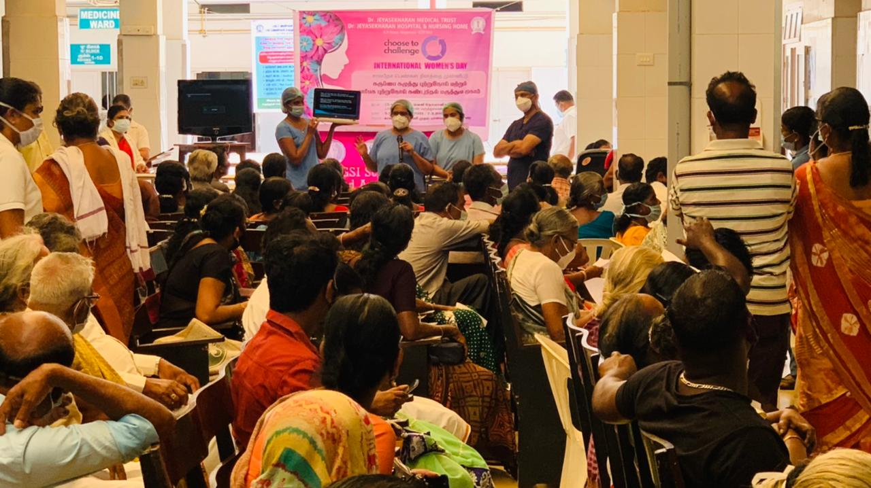
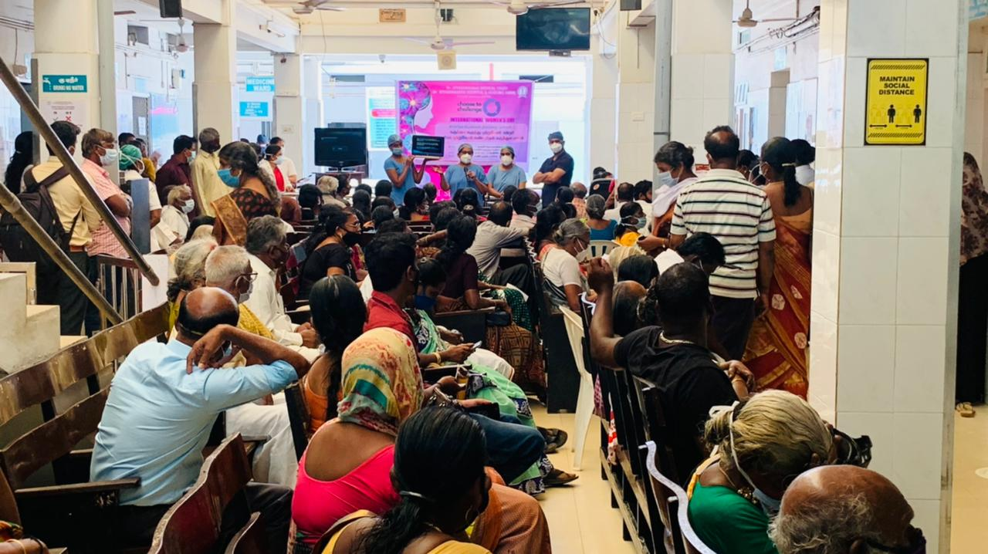

Slide 22
NOGS project 15 WDP (14) Dr.Selvapriya Saravanan organized an Awareness Programme and Women’s day Culturals competitions for students of Arunachala college .....

Slide 23
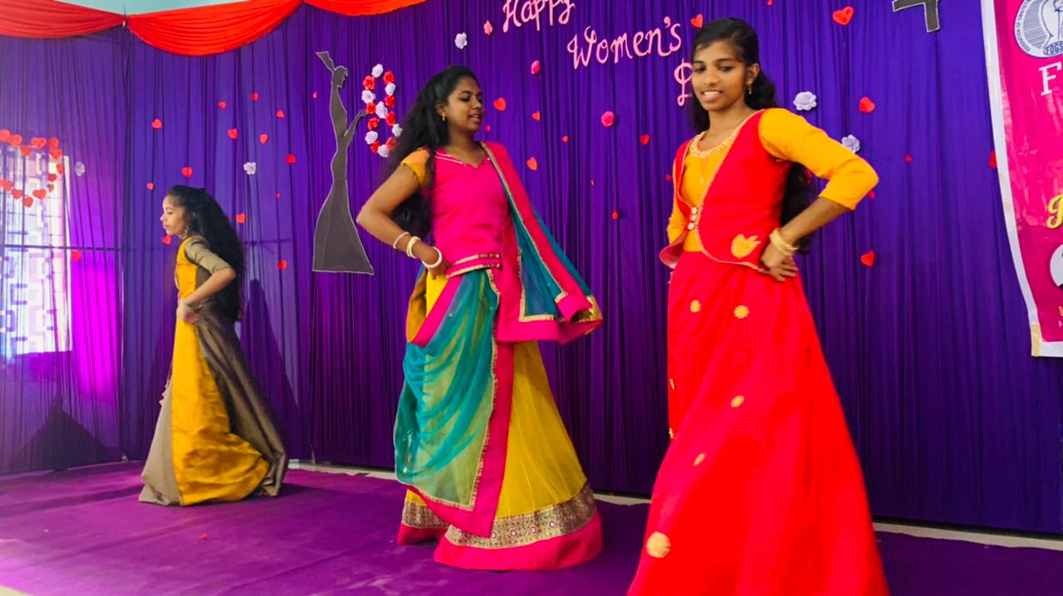
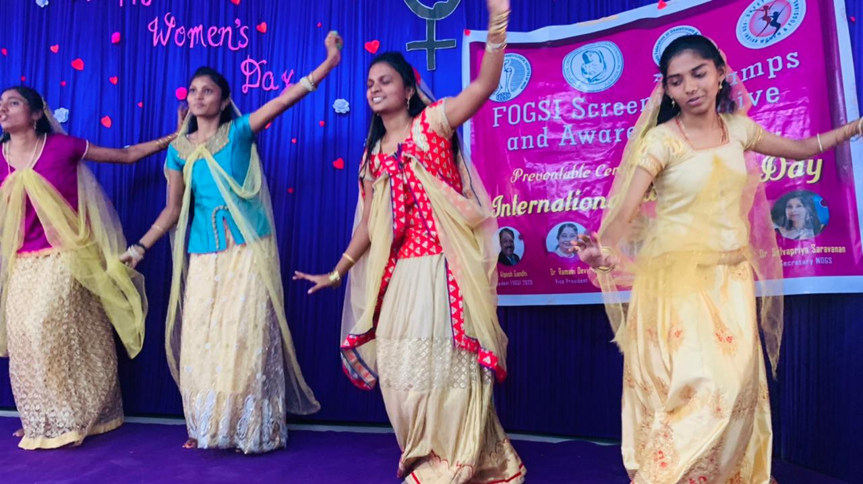
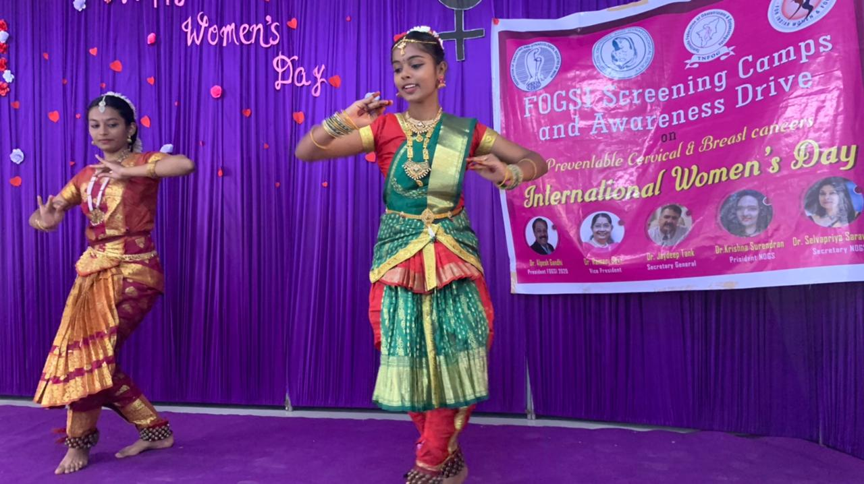
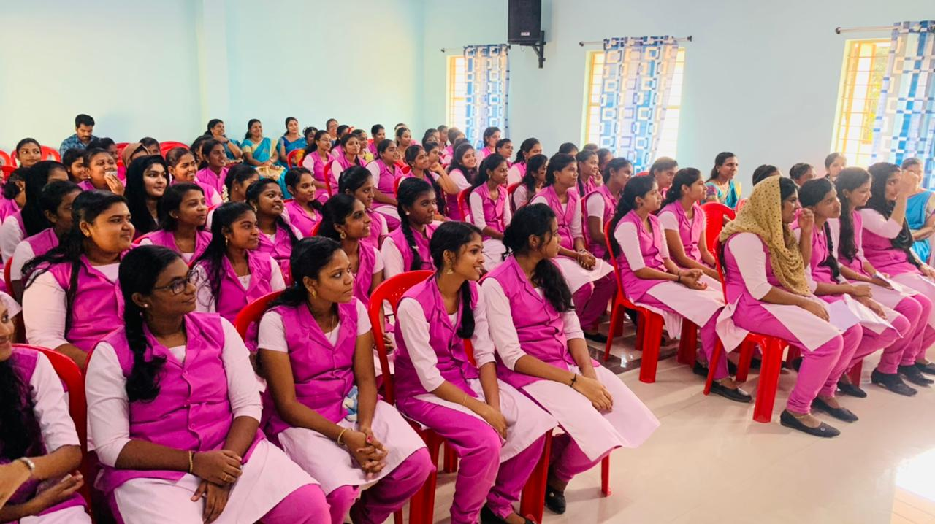
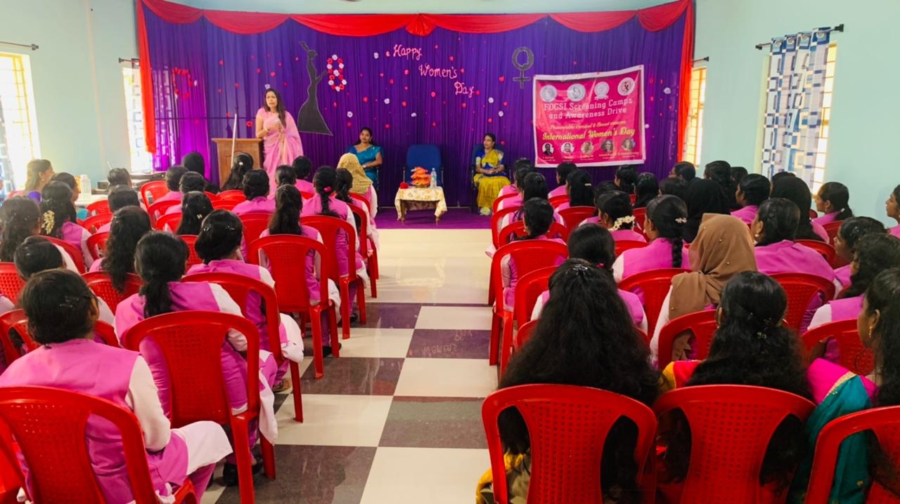

Slide 24
NOGS project 15 WDP (6).. Dr.Renganayaki senior Gynaecologist of our society was honoured by Hindu Vidhyalaya school for her services and she did an awareness programme on cancer screening and all the teachers of the school are undergoing screening today .....

Slide 25
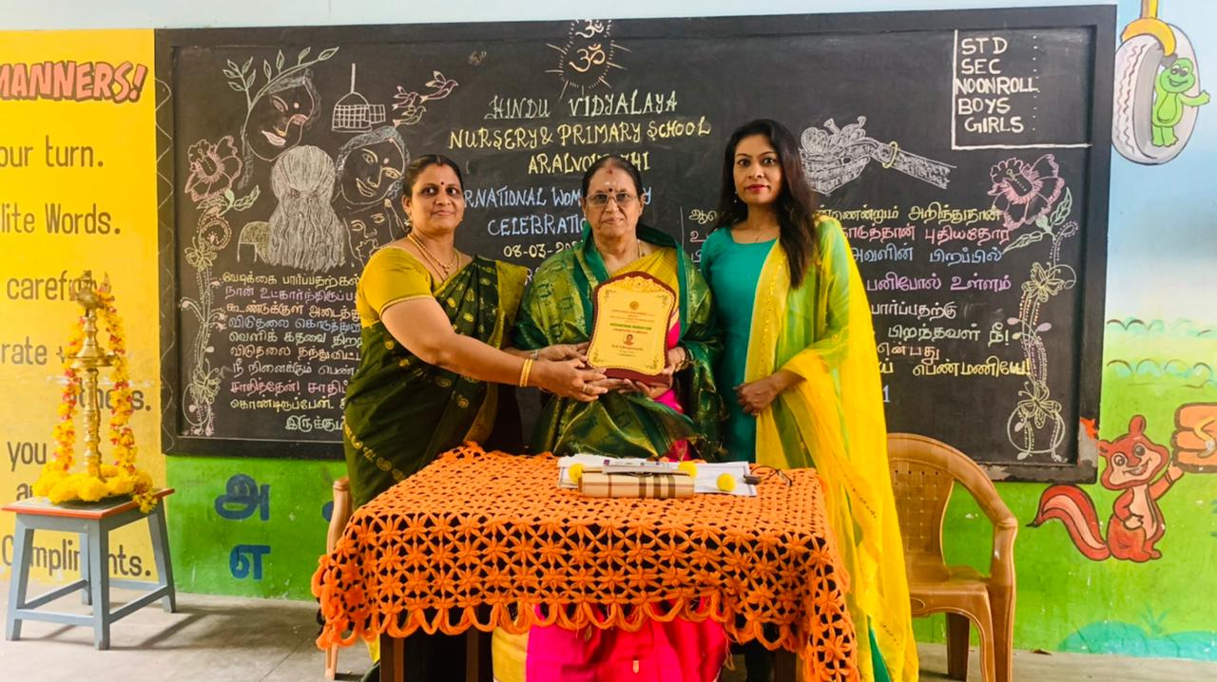






Slide 26




Slide 27
NOGS project 15 WDP (17) Dr.Sudha Sundar our Treasurer did a Cancer Awareness Programme and Screening as part of NOGS Women's Day Celebrations in Sudha Sundar hospital

Slide 28





Slide 29
NOGS project 15- WDP (23) Dr.Sudha Sudhar of Sudha sundar Hospital, Putheri and our Treasurer did the FOGSI / TNFOG Cancer Screening and Awareness Programme for Nagercoil Obstetrics and Gynaecological society....

Slide 30




Slide 31


Our PP Dr Mary Ann was honoured with 2 awards in this women’s day 😍Women's Day Award 2021- Noorul Islam College of Arts & Sciences 😍 Inspirational Woman Award 2021- Cape Forum….

Slide 32
NOGS Project 19 (3/24 ) ., Dr.Mary Ann pp NOGS and TNFOG EC Member conducted an Awareness Programme on violence against Women in Nooral Islam College of Arts and Science with TNFOG

Slide 33





Slide 34
NOGS project 15- WDP (20) Dr.Christabel Reena our senior Gynaec and EC member, CSI Mission Hospital, NEYOOR did a Cancer Awareness Programme and Screening Camp as part of FOGSI NOGS TNFOG International Women’s Day Celebrations….

Slide 35





Slide 36
NOGS project 15- WDP (22) Dr.Christabel Reena CSI Mission Hospital, Neyoor did the FOGSI Cancer Screening Programme for Nagercoil Obstetrics and Gynaecological society....

Slide 37



Slide 38
NOGS project 15- WDP (21) Dr.Dhana Lakshmi and Dr.Udhaya Banu did the FOGSI Cancer Awareness and Screening Programme for NOGS

Slide 39






Slide 40


NOGS Project 17 (3/24) .... Health Awareness Programme for Teachers by Dr.Banumathy Preventive Oncologist and Joint Treasurer of NOGS ....

Slide 41


NOGS - project 21-(3/24)., Dr.Banumathy, Our Joint Treasures NOGS and preventive oncologist did Adolescent Health Education and Awareness on Child Abuse for boys and girls at Echanvillai School... For the village school children on 17 .3.2021

Slide 42
NOGS project 15 WDP (19) Dr.Banumathy, Sushrushah Hospital, Nagercoil our Joint Treasurer did an Awareness Programme and Screening Camp as part of FOGSI NOGS Women's Day Celebrations…

Slide 43





Slide 44
NOGS Project 16 (3/24) .... Adolescent Health awareness Programme for students of WCC Nagercoil by Dr.Shanthi Magilan .. Senior Fertility Specialist and Scientific Committee head of NOGS ....

Slide 45







Slide 46
# NOGS project 15- WDP (25) awareness programme and talk on Women's Day at Vivekananda Kendra, Kanyakumari by Cape Trust Forum, Nagercoil Awareness camp at Williams hospital by Dr.Susan…

Slide 47




Slide 48
Dr.Uma Selvan madam did an awareness programme for cancer awareness…

Slide 49



Slide 50
NOGS project 15 WDP (7).. Dr.Ananthi MK, Senior Gynaecologist and vice president of our society did the FOGSI cancer screening camp on March 8

Slide 51



Slide 52
NOGS project 15 WDP (18) Dr.Felsit Punitha senior practitioner and Dr.Divya Ranjith Ec NOGS did a Cancer Awareness Programme and screening as part of NOGS Women's Day Celebrations in PPK hospital Marthandam…

Slide 53





Slide 54







Slide 55
NOGS project 15 WDP (16) Dr.Shiney Anand did a FOGSI Cancer Awareness Programme as part of NOGS Women's Day Celebrations in Ayyapa college

Slide 56




Slide 57
NOGS project 15 WDP (15) Dr.USHA organized a camp and awareness programme as part of NOGS Women's Day Celebrations

Slide 58






Slide 59


Usha madam did a Colposcopy camp

Slide 60
NOGS PROJECT
By
Dr. SHEEBA JAYALAL

Slide 61





Slide 62
NOGS project 15 WDP (11) Dr.Jesudha Michael MJ Hospital did the FOGSI Cancer Awareness Programme and screening camp for public on March 8

Slide 63



Slide 64
NOGS project 15 WDP (9) Dr.Shanthi Magilan of our society did the FOGSI Cancer Awareness Programme screening camp on March 8 in RATNA Hospital Swamiyaar Madam.... 30 mammograms were done in this camp…..

Slide 65




Slide 66





Slide 67


NOGS Project 18 (3/4), Dr.SHANTHI MAGILANS skit for ENDOMETRIOSIS Awareness has won the first place in the International ENDO Sight Conference for Endometriosis

Slide 68




Slide 69
NOGS project 15 WDP (8) Dr.Asha of our society did the FOGSI Cancer Awareness Programme screening camp on March 8 in VIJAYAKUMAR HOSPITAL

Slide 70





Slide 71


Slide 72

DR.SANTHI GOT THE FIRST PLACE FOR NOGS WITH ER ENDOMETRISIS AWARENESS SHORT FILM IN THE INTERNATIONAL ENDOINSIGHT CONFERENCE

Slide 73



Slide 74


NOGS project 15- WDP (24), Dr.Mary Ann PP NOGS did the FOGSI / TNFOG Cancer Screening and Awareness programme for Nagercoil Obstetrics and Gynaecological society....

Slide 75

ACADEMICS

Slide 76

ENDOMETRIOSIS COMMITTEE - FOGSI

Slide 77



Slide 78




Slide 79



Slide 80


Slide 81



Slide 82




Slide 83


Slide 84




Slide 85




Slide 86
SO A SHORT SUMMARY OF MARCH
PROJECTS 13 TO 22 HAPPENED
PROJECT 15 WP HAD 25 PROGRAMMES
NOGS RECOGNITION IN VARIOUS FORUMS
AWARDS RECEIVED BY NOGSIANS

Slide 87


